Slide 1
</
Hypothesis Testing />
B068 - Vidhi Damani
1 0 1 1 0 1 1 0 1 1 0 1 1 0 0 1 1 0 1 1 0 1 1 0 1 1 0 1 1 1 0 1 1 0 1 1 0 1 1 1 1 1 0 1

Slide 2

</Content
Data Implementation þ Analysis
Data Description
Domain Theory
Data Cleaning

Slide 3
</Domain Theory
Hypothesis testing is a type of statistical analysis in which you put your assumptions about a population parameter to a test. It is used to estimate relationship between 2 statistical variables.
How does it work?
Measurements and analysis are conducted on a random sample of the population to test a theory.
Analysts use a random population sample to test two hypotheses: the null and alternative hypothesis.
Example from real life:
- A teacher assumes that 60% of his students come from lower middle class families
1 0 1 1
1 0 1 1 0 0 1
1 0
1 1 0 1 1
0 1 1
0 1
1 1 0 1 1 0
1 1 0 1 1 1
1 1 0 1

Slide 4
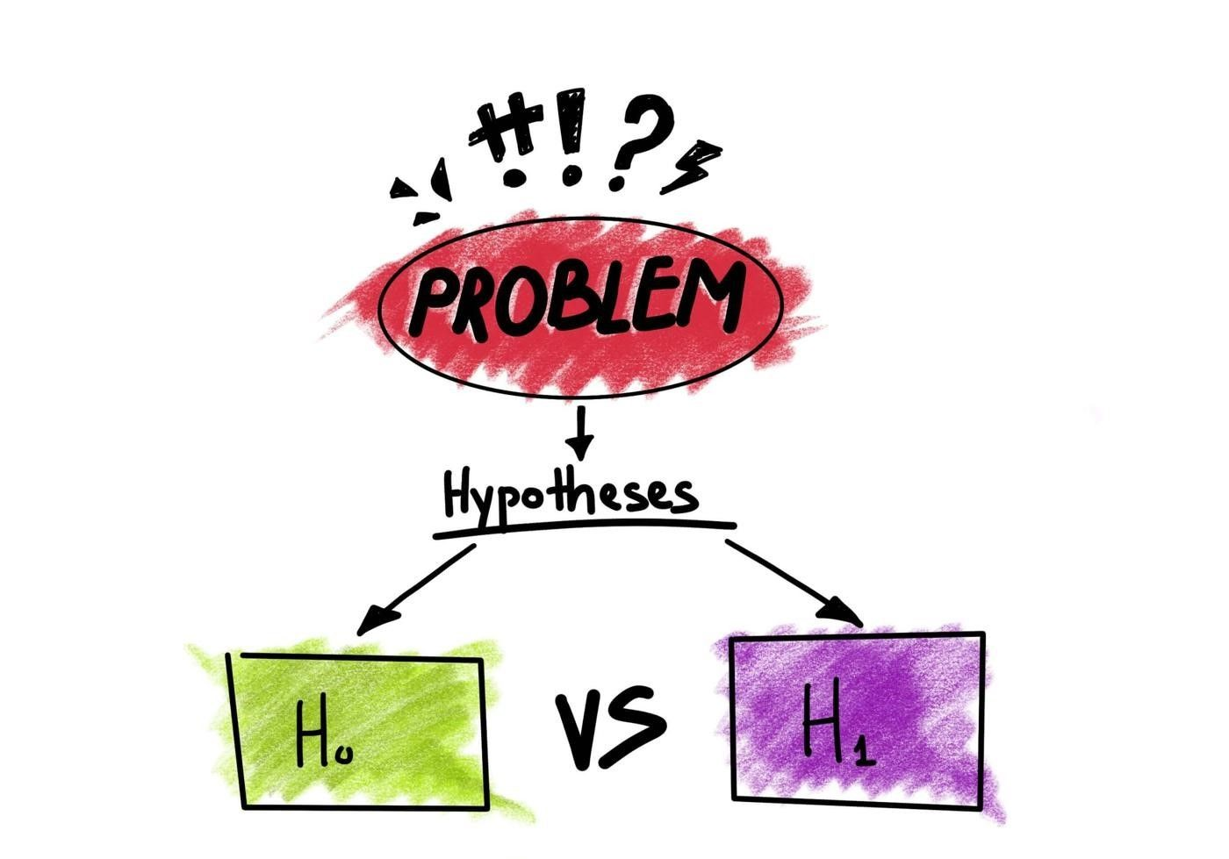
NULL HYPOTHESIS
It is usually a hypothesis of equality between population parameters, ie no statistical significance exists in a set of given observation.
ALTERNATE HYPOTHESIS
It is the logical opposite of the null hypothesis, the acceptance of alternate hypothesis follows the rejection of the null hypothesis.
It is essentially of two types - one tailed and two tailed
1 0 1 1
1 0 1 1 0 0 1
1 0
1 1 0 1 1
0 1 1
0 1
1 1 0 1 1 0
1 1 0 1 1 1
1 1 0 1

Slide 5
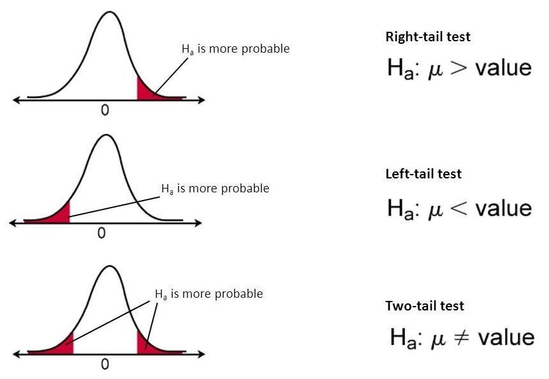
One tailed alternative hypothesis is a directional test that considers a critical region that would result in null hypothesis being rejected if sample falls into it. The one tailed hypothesis be be right tailed or left tailed
Two tailed alternative hypothesis is designed to show whether the sample mean is significantly less than the mean of a population
1 0 1 1
1 0 1 1 0 0 1
1 0
1 1 0 1 1
0 1 1
0 1
1 1 0 1 1 0
1 1 0 1 1 1
1 1 0 1

Slide 6
SIGNIFICANCE LEVEL
The significance level, also denoted as alpha or α, is the probability of rejecting the null hypothesis when it is true. For example, a significance level of 0.05 indicates a 5% risk of concluding that a difference exists when there is no actual difference.
In practice, the most commonly used alpha values are 0.01, 0.05, and 0.1, which represent a 1%, 5%, and 10% chance of a Type I error, respectively
P VALUES
P-values are the probability of obtaining an effect at least as extreme as the one in your sample data, assuming the truth of the null hypothesis.
As the p-value decreases the statistical significance of the observed
difference increases. If the p-value is too low, you reject the null hypothesis.
If P value <= Significance Level -> Reject Null Hypothesis If P Value > Significance Level -> Accept Null Hypothesis
1 0 1 1
1 0 1 1 0 0 1
1 0
1 1 0 1 1
0 1 1
0 1
1 1 0 1 1 0
1 1 0 1 1 1
1 1 0 1

Slide 7
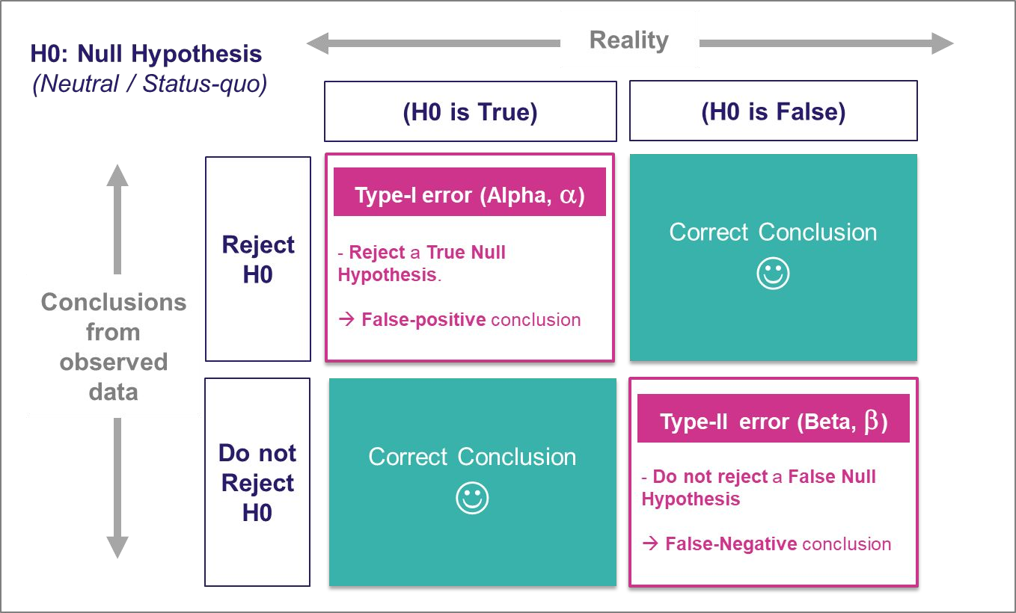
ERRORS
Type 1 Error
Rejecting the null hypothesis when it is actually true
Type 2 Error
Not rejecting the null hypothesis when it is actually false
1 0 1 1
1 0 1 1 0 0 1
1 0
1 1 0 1 1
0 1 1
0 1
1 1 0 1 1 0
1 1 0 1 1 1
1 1 0 1

Slide 8

TYPES OF HYPOTHESIS TESTS
1. One Sample Z test
A one-sample Z-test is a statistical hypothesis test used to determine whether the mean of a sample from a population is significantly different from a known or hypothesized population mean. It is typically used when the population standard deviation (σ) is known.
If the absolute value of the Z-score is greater than the critical Z-value (for a critical value approach) or if the p-value is less than α (for a p-value approach), you reject the null hypothesis in favor of the alternative hypothesis.
If the absolute value of the Z-score is less than or equal to the critical Z-value (for a critical value approach) or if the p-value is greater than or equal to α (for a p-value approach), you fail to reject the null hypothesis.
1 0 1 1
1 0 1 1 0 0 1
1 0
1 1 0 1 1
0 1 1
0 1
1 1 0 1 1 0
1 1 0 1 1 1
1 1 0 1

Slide 9
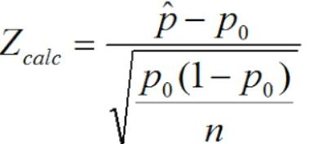
2. One Sample Proportion Test
A one-sample proportion test, also known as a one-sample z-test for proportions, is a statistical hypothesis test used to determine whether the proportion of a specific characteristic in a single sample is significantly different from a hypothesized population proportion. This test is commonly used in situations where you want to assess whether a sample proportion is different from a known or assumed population proportion.
If the absolute value of the Z-score is greater than the critical Z-value (for a critical value approach) or if the p-value is less than α (for a p-value approach), you reject the null hypothesis in favor of the alternative hypothesis.
If the absolute value of the Z-score is less than or equal to the critical Z-value (for a critical value approach) or if the p-value is greater than or equal to α (for a p-value approach), you fail to reject the null hypothesis.
1 0 1 1
1 0 1 1 0 0 1
1 0
1 1 0 1 1
0 1 1
0 1
1 1 0 1 1 0
1 1 0 1 1 1
1 1 0 1

Slide 10
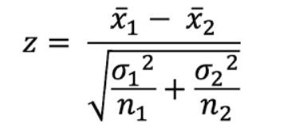
3. Two Sample Z test
A two-sample Z-test is a statistical hypothesis test used to compare the means of two independent samples to determine if they are significantly different from each other. This test is often used when you have two groups or treatments and you want to assess whether there is a statistically significant difference in the means of some variable between these two groups. The test assumes that you know the population standard deviations (σ1 and σ2) for both groups.
If the absolute value of the Z-score is greater than the critical Z-value (for a critical value approach) or if the p-value is less than α (for a p-value approach), you reject the null hypothesis in favor of the alternative hypothesis.
If the absolute value of the Z-score is less than or equal to the critical Z-value (for a critical value approach) or if the p-value is greater than or equal to α (for a p-value approach), you fail to reject the null hypothesis.
1 0 1 1
1 0 1 1 0 0 1
1 0
1 1 0 1 1
0 1 1
0 1
1 1 0 1 1 0
1 1 0 1 1 1
1 1 0 1

Slide 11
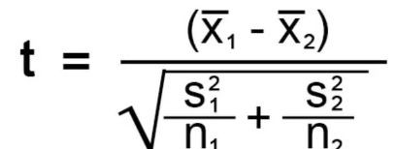
4. Two Sample T Test
A two-sample t-test is a statistical hypothesis test used to determine whether there is a significant difference between the means of two independent samples. This test is particularly useful when you want to compare the means of two groups to determine if they are statistically different from each other. The most common version of the
two-sample t-test assumes that the populations from which the samples are drawn are approximately normally distributed and have approximately equal variances.
If the absolute value of the t-score is greater than the critical t-value (for a critical value approach) or if the p-value is less than α (for a p-value approach), you reject the null hypothesis in favor of the alternative hypothesis.
If the absolute value of the t-score is less than or equal to the critical t-value (for a critical value approach) or if the p-value is greater than or equal to α (for a p-value approach), you fail to reject the null hypothesis.
1 0 1 1
1 0 1 1 0 0 1
1 0
1 1 0 1 1
0 1 1
0 1
1 1 0 1 1 0
1 1 0 1 1 1
1 1 0 1

Slide 12

4. Chi-Squared Goodness of Fit Test
This test is used to determine whether an observed frequency distribution of a categorical variable fits an expected theoretical distribution. It compares the observed frequencies to the expected frequencies under a specific hypothesis. The formula for the chi-squared statistic in this case is:
The chi-squared goodness of fit test typically uses a chi-squared distribution to determine the p-value, which helps assess the significance of the difference between observed and expected frequencies.
1 0 1 1
1 0 1 1 0 0 1
1 0
1 1 0 1 1
0 1 1
0 1
1 1 0 1 1 0
1 1 0 1 1 1
1 1 0 1

Slide 13
5. Chi-Squared Test of Independence
This test is used to determine whether there is a significant association or independence between two categorical variables. It is often presented in the form of a contingency table (also known as a cross-tabulation or two-way table) that shows the joint distribution of the two categorical variables. The formula for the chi-squared statistic in this case is:
The chi-squared test of independence assesses whether there is a statistically significant relationship between the two categorical variables by comparing the observed and expected frequencies
1 0 1 1
1 0 1 1 0 0 1
1 0
1 1 0 1 1
0 1 1
0 1
1 1 0 1 1 0
1 1 0 1 1 1
1 1 0 1

Slide 14

</ Data Description
This dataset provides comprehensive information about crime incidents reported in Los Angeles from January 2020 to June 2023. It includes details such as the type of crime, date and time of occurrence, location, and other relevant attributes. The dataset is sourced from the Los Angeles Police Department and offers valuable insights into crime patterns and trends in the city.
1 0 1 1
1 0 1 1 0 0 1
1 0
1 1 0 1 1
0 1 1
0 1
1 1 0 1 1 0
1 1 0 1 1 1
1 1 0 1

Slide 15
Attributes
DR_NO - division of records number: official file number
Date Rptd - date when crime was reported (DD-MM-YYYY)
DATE OCC - date of crime occurrence (DD-MM-YYYY)
TIME OCC - time of crime occurrence
AREA - the LAPD has 21 Community Police Stations, they are given numbers from 1 to 21
AREA NAME - the patrol division are also given a name that references a landmark or the surrounding community
Rpt Dist No - code that represents a sub-area within a geographical area
Crm Cd - crime code
Crm Cd Desc - crime code description
1 0 1 1
1 0 1 1 0 0 1
1 0
1 1 0 1 1
0 1 1
0 1
1 1 0 1 1 0
1 1 0 1 1 1
1 1 0 1

Slide 16
Vict Age - victim age
Vict Sex - gender of the victim
Vict Descent - A - Other Asian B - Black C - Chinese D -
Cambodian F - Filipino G - Guamanian H -
Hispanic/Latin/Mexican I - American Indian/Alaskan Native | J | -
Japanese K - Korean L - Laotian O - Other P - Pacific
Islander S - Samoan U - Hawaiian V - Vietnamese W - White | X | -
Unknown Z - Asian Indian
Premis Cd - premise code
Premis Desc - premise description
Weapon Desc - weapon description
Status - AO(adult other), IC(invert cont), AA(adult arrest)
LAT - latitude coordinates
LON - longitude coordinates
1 0 1 1
1 0 1 1 0 0 1
1 0
1 1 0 1 1
0 1 1
0 1
1 1 0 1 1 0
1 1 0 1 1 1
1 1 0 1

Slide 17
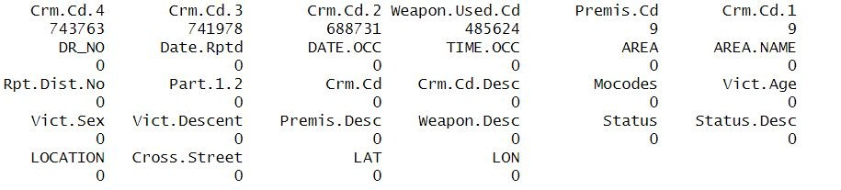
</ Data Cleaning
OLD DATASET
1 0 1 1
1 0 1 1 0 0 1
1 0
1 1 0 1 1
0 1 1
0 1
1 1 0 1 1 0
1 1 0 1 1 1
1 1 0 1

Slide 18
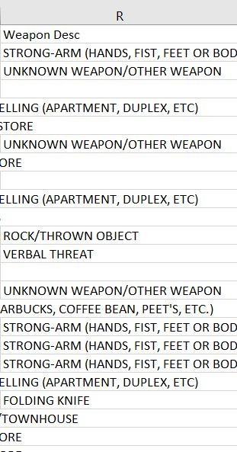
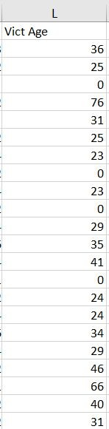
Missing values
Blank spaces
0 as data in many columns
1 0 1 1
1 0 1 1 0 0 1
1 0
1 1 0 1 1
0 1 1
0 1
1 1 0 1 1 0
1 1 0 1 1 1
1 1 0 1

Slide 19
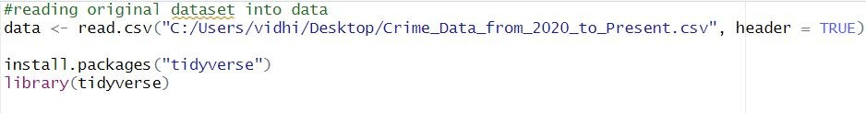

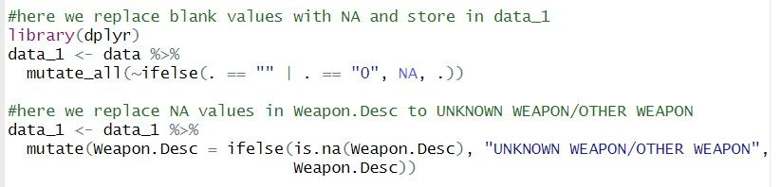
1 0 1 1
1 0 1 1 0 0 1
1 0
1 1 0 1 1
0 1 1
0 1
1 1 0 1 1 0
1 1 0 1 1 1
1 1 0 1

Slide 20
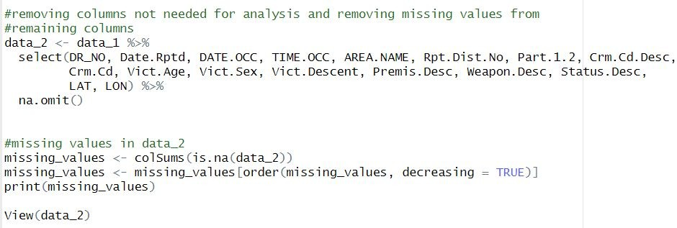
1 0 1 1
1 0 1 1 0 0 1
1 0
1 1 0 1 1
0 1 1
0 1
1 1 0 1 1 0
1 1 0 1 1 1
1 1 0 1

Slide 21
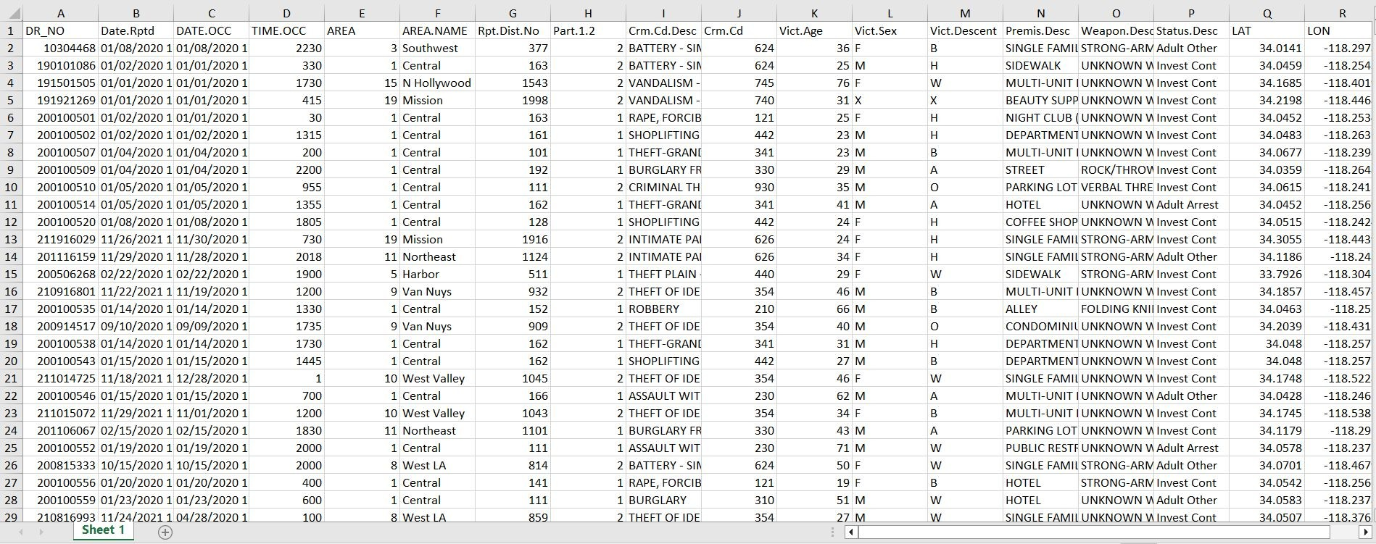
NEW DATASET
1 0 1 1
1 0 1 1 0 0 1
1 0
1 1 0 1 1
0 1 1
0 1
1 1 0 1 1 0
1 1 0 1 1 1
1 1 0 1

Slide 22
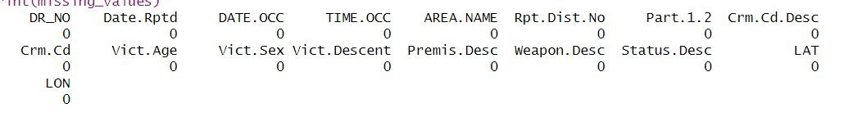
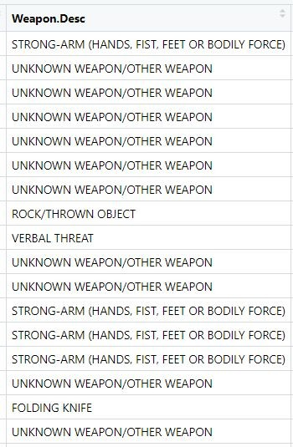
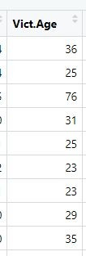
- Removed the rows with null values and replaced the blank spaces in weapon desc with
UNKNOWN WEAPON/OTHER WEAPON
1 0 1 1
1 0 1 1 0 0 1
1 0
1 1 0 1 1
0 1 1
0 1
1 1 0 1 1 0
1 1 0 1 1 1
1 1 0 1

Slide 23
</ Data Implementation þ Analysis
1. 1 Sample Proportion test
Data Implementation:
For the given dataset, it is hypothesized that 80% of crimes are committed in 'Central' area. Using proportion test verify the hypothesis for a sample size of 1000.
Null Hypothesis: Hypothesized proportion (p) = 0.8
Alternate Hypothesis: Hypothesized proportion (p) != 0.80 (Two Tailed)
1 0 1 1
1 0 1 1 0 0 1
1 0
1 1 0 1 1
0 1 1
0 1
1 1 0 1 1 0
1 1 0 1 1 1
1 1 0 1

Slide 24
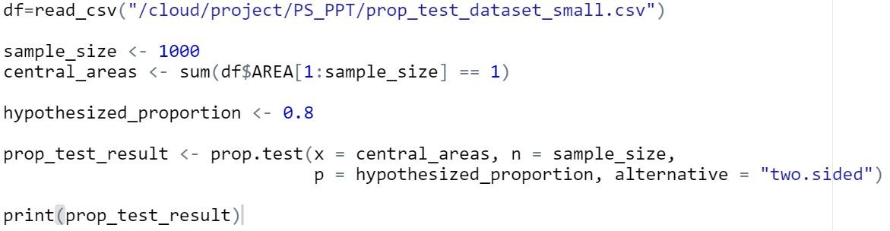
Code:
1 0 1 1
1 0 1 1 0 0 1
1 0
1 1 0 1 1
0 1 1
0 1
1 1 0 1 1 0
1 1 0 1 1 1
1 1 0 1

Slide 25
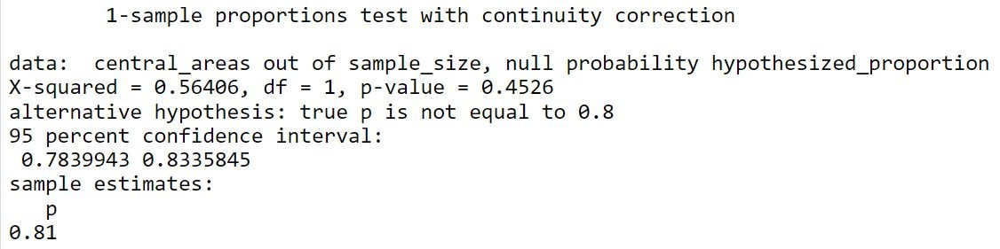
Data Analysis
Output
1 0 1 1
1 0 1 1 0 0 1
1 0
1 1 0 1 1
0 1 1
0 1
1 1 0 1 1 0
1 1 0 1 1 1
1 1 0 1

Slide 26
2. 1 sample Z test
Data Implementation:
From the cleaned dataset, mean victim age is 36.5618 years with std dev of 15.57. Can we assume the mean age for the first 10000 victims be 40 years where?
Null Hypothesis: Mean victim age = 40
Alternate Hypothesis: Mean victim age !=40 (Two Tailed)
1 0 1 1
1 0 1 1 0 0 1
1 0
1 1 0 1 1
0 1 1
0 1
1 1 0 1 1 0
1 1 0 1 1 1
1 1 0 1

Slide 27
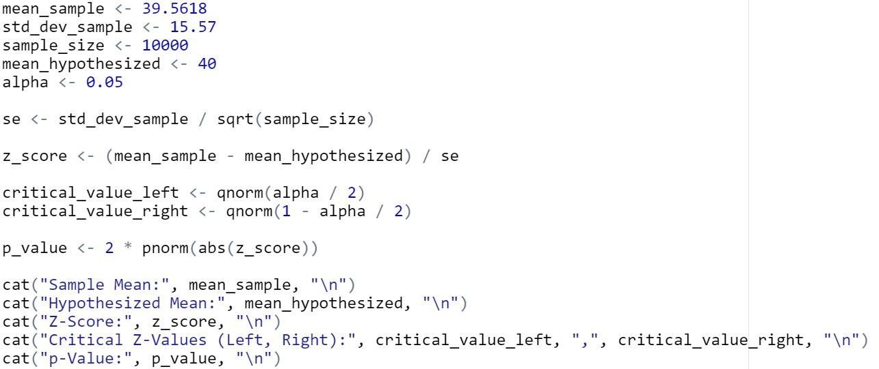
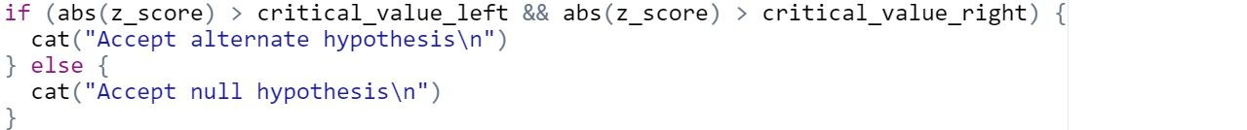
Code:
1 0 1 1
1 0 1 1 0 0 1
1 0
1 1 0 1 1
0 1 1
0 1
1 1 0 1 1 0
1 1 0 1 1 1
1 1 0 1

Slide 28
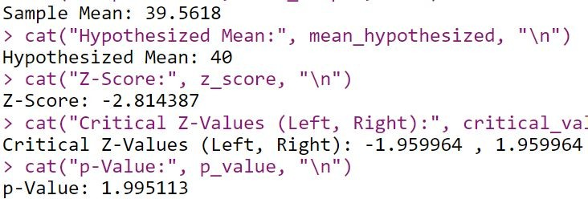
Data Analysis
Output
1 0 1 1
1 0 1 1 0 0 1
1 0
1 1 0 1 1
0 1 1
0 1
1 1 0 1 1 0
1 1 0 1 1 1
1 1 0 1

Slide 29
3. Z test with 2 samples
Data implementation:
If 282816 male victims have located at an mean latitude of 34.080147 and standard deviation 0.107628 whereas 271024 female victims are located at a mean latitude 34.070666and having standard deviation 0.103647. does this data indicates that there are more male victims than female victims.
NULL HYPOTHESIS - The mean latitude of male victims is equal to the mean latitude of female victims.
ALTERNATE HYPOTHESIS - The mean latitude of male victims is more than the mean latitude of female victims.( right tailed )
1 0 1 1
1 0 1 1 0 0 1
1 0
1 1 0 1 1
0 1 1
0 1
1 1 0 1 1 0
1 1 0 1 1 1
1 1 0 1

Slide 30
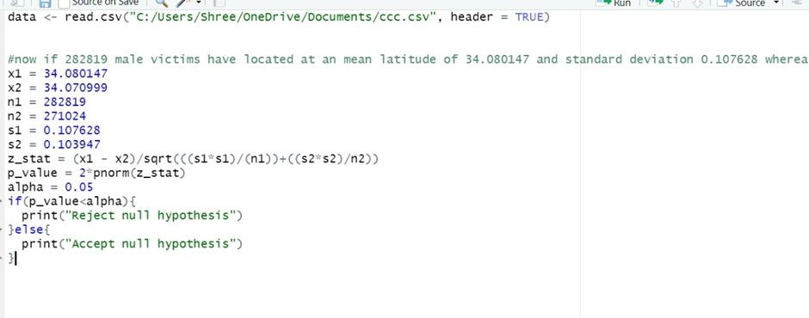
code
1 0 1 1
1 0 1 1 0 0 1
1 0
1 1 0 1 1
0 1 1
0 1
1 1 0 1 1 0
1 1 0 1 1 1
1 1 0 1

Slide 31
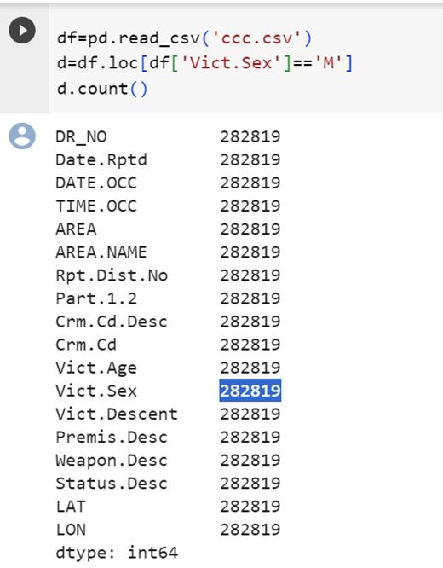
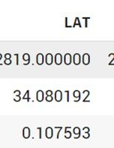
Data analysis:
Male:
1 0 1 1
1 0 1 1 0 0 1
1 0
1 1 0 1 1
0 1 1
0 1
1 1 0 1 1 0
1 1 0 1 1 1
1 1 0 1

Slide 32
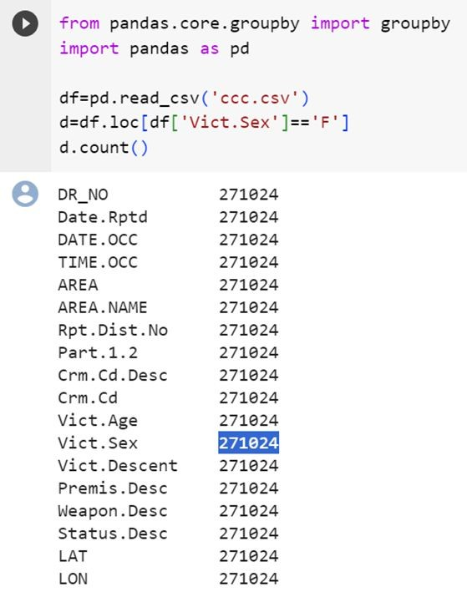
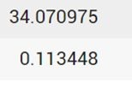
Female:
1 0 1 1
1 0 1 1 0 0 1
1 0
1 1 0 1 1
0 1 1
0 1
1 1 0 1 1 0
1 1 0 1 1 1
1 1 0 1

Slide 33
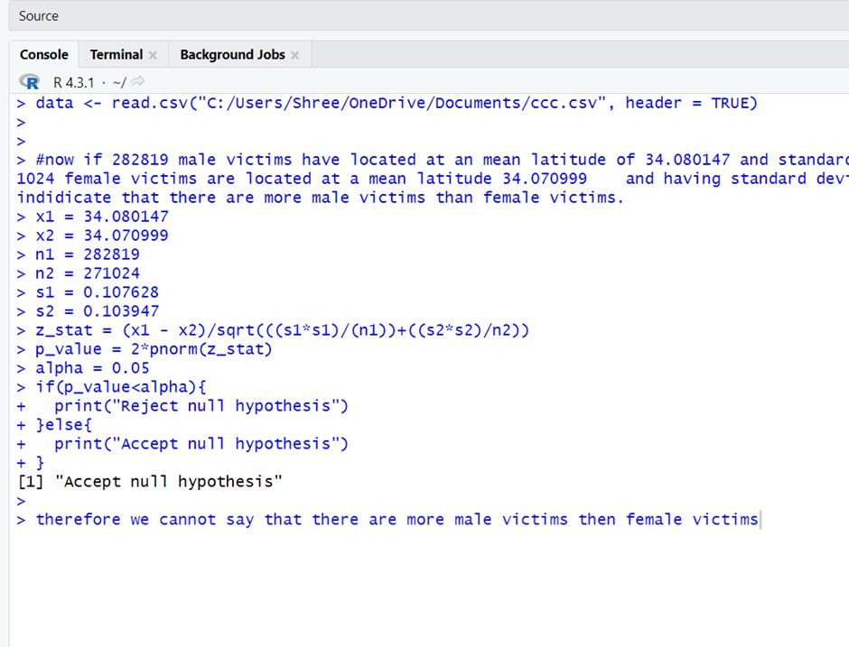
Output:
1 0 1 1
1 0 1 1 0 0 1
1 0
1 1 0 1 1
0 1 1
0 1
1 1 0 1 1 0
1 1 0 1 1 1
1 1 0 1

Slide 34
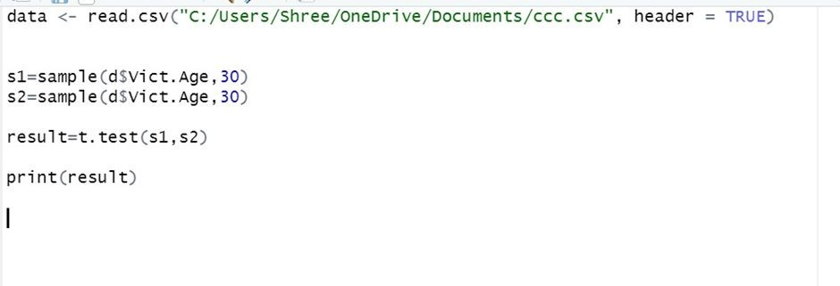
4. T test with 2 sample
Data Implementation
NULL HYPOTHESIS - no statistical significant difference between the two samples
ALTERNATIVE HYPOTHESIS- the mean of first sample is not equal to the other( two tailed )
Code:
1 0 1 1
1 0 1 1 0 0 1
1 0
1 1 0 1 1
0 1 1
0 1
1 1 0 1 1 0
1 1 0 1 1 1
1 1 0 1

Slide 35
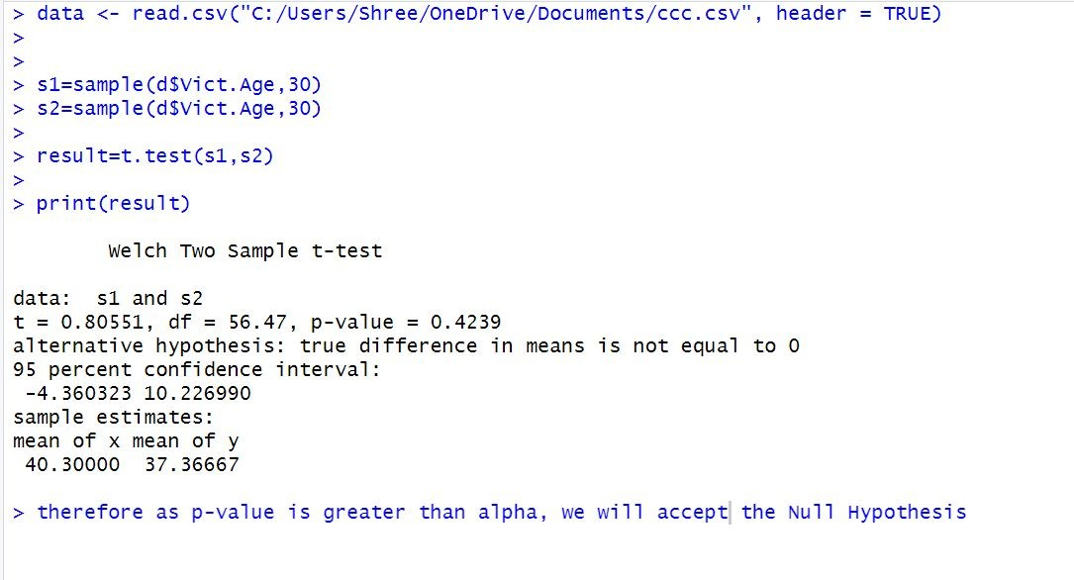
Data analysis:
Output
1 0 1 1
1 0 1 1 0 0 1
1 0
1 1 0 1 1
0 1 1
0 1
1 1 0 1 1 0
1 1 0 1 1 1
1 1 0 1

Slide 36
5. Chi-Squared goodness of fit test
Data Implementation
Null Hypothesis : There is no significant association between the ethnicity ("Descent") of individuals and the number of crimes committed against them. The ethnicity of individuals and the number of crimes are independent, and the observed frequencies of crimes for each ethnicity follow a uniform distribution.
Alternate Hypothesis : The ethnicity of individuals and the number of crimes are not independent; they are associated in some way. The observed frequencies of crimes for each ethnicity do not follow a uniform distribution, indicating a significant association or dependence between ethnicity and the number of crimes.
1 0 1 1
1 0 1 1 0 0 1
1 0
1 1 0 1 1
0 1 1
0 1
1 1 0 1 1 0
1 1 0 1 1 1
1 1 0 1

Slide 37
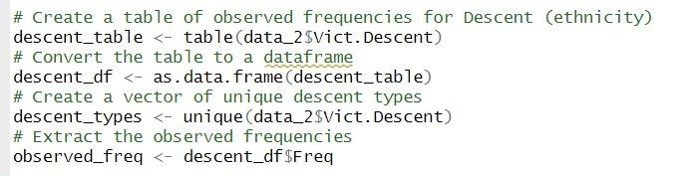
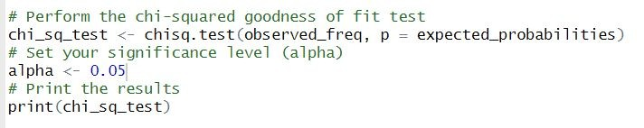
Code
1 0 1 1
1 0 1 1 0 0 1
1 0
1 1 0 1 1
0 1 1
0 1
1 1 0 1 1 0
1 1 0 1 1 1
1 1 0 1

Slide 38
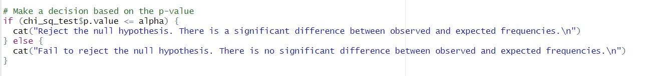
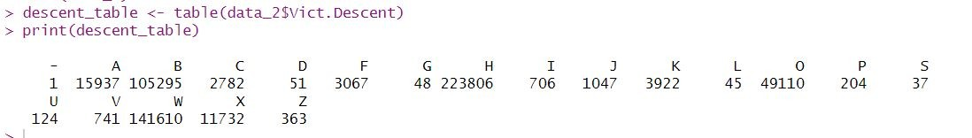
Data Analysis
1 0 1 1
1 0 1 1 0 0 1
1 0
1 1 0 1 1
0 1 1
0 1
1 1 0 1 1 0
1 1 0 1 1 1
1 1 0 1

Slide 39
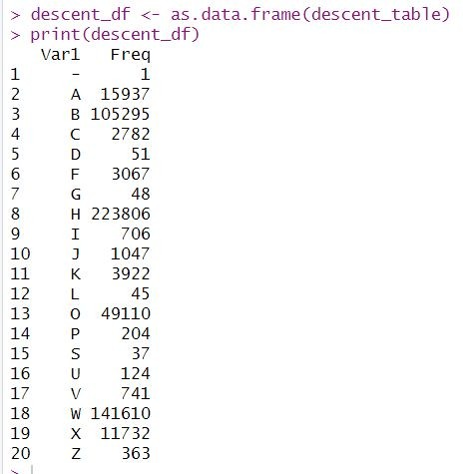
1 0 1 1
1 0 1 1 0 0 1
1 0
1 1 0 1 1
0 1 1
0 1
1 1 0 1 1 0
1 1 0 1 1 1
1 1 0 1

Slide 40
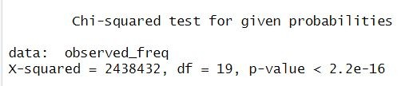
Output
1 0 1 1
1 0 1 1 0 0 1
1 0
1 1 0 1 1
0 1 1
0 1
1 1 0 1 1 0
1 1 0 1 1 1
1 1 0 1

Slide 41
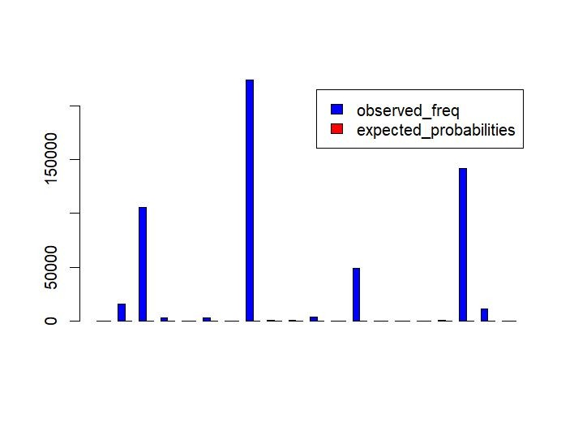
1 0 1 1
1 0 1 1 0 0 1
1 0
1 1 0 1 1
0 1 1
0 1
1 1 0 1 1 0
1 1 0 1 1 1
1 1 0 1

Slide 42
6. Chi-Squared test of independence
Data Implementation
Null Hypothesis : There is no significant association between gender and time of day. In other words, the gender of individuals and the time of day when crimes occur are independent of each other.
Alternate Hypothesis : There is a significant association between gender and time of day. In other words, the gender of individuals and the time of day when crimes occur are not independent; they are associated in some way.
1 0 1 1
1 0 1 1 0 0 1
1 0
1 1 0 1 1
0 1 1
0 1
1 1 0 1 1 0
1 1 0 1 1 1
1 1 0 1

Slide 43
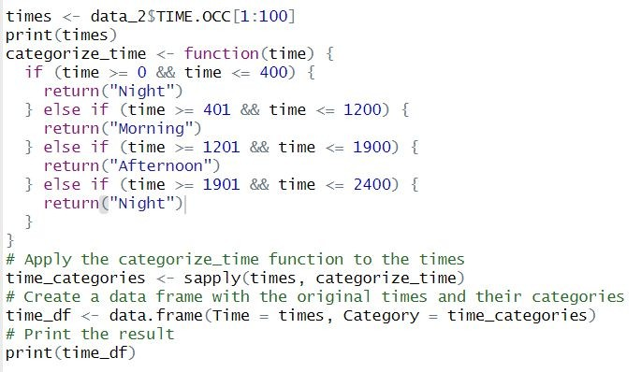
Code
1 0 1 1
1 0 1 1 0 0 1
1 0
1 1 0 1 1
0 1 1
0 1
1 1 0 1 1 0
1 1 0 1 1 1
1 1 0 1

Slide 44
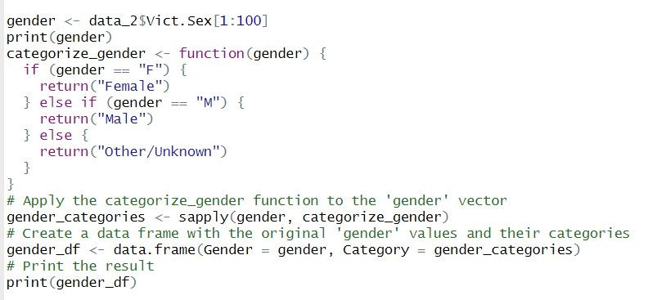
1 0 1 1
1 0 1 1 0 0 1
1 0
1 1 0 1 1
0 1 1
0 1
1 1 0 1 1 0
1 1 0 1 1 1
1 1 0 1

Slide 45
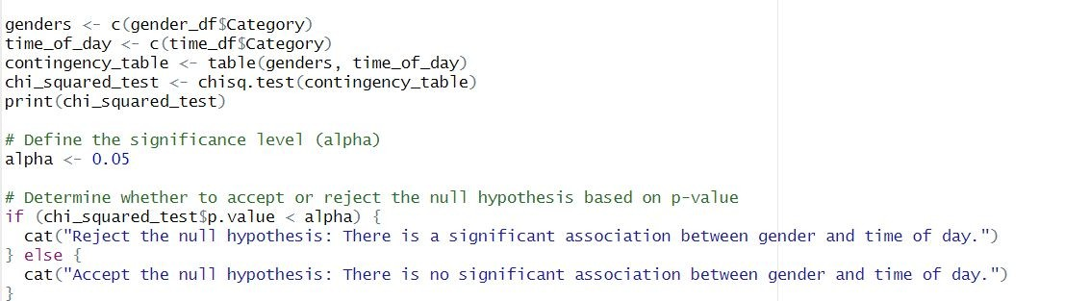
1 0 1 1
1 0 1 1 0 0 1
1 0
1 1 0 1 1
0 1 1
0 1
1 1 0 1 1 0
1 1 0 1 1 1
1 1 0 1

Slide 46
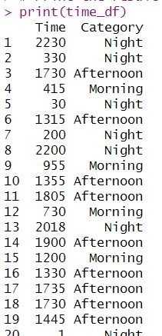
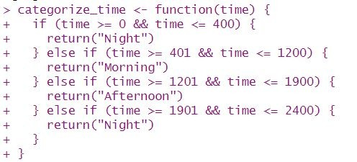
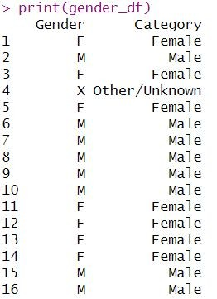
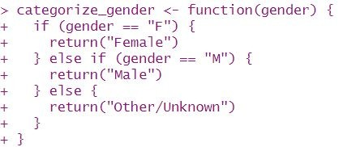
Data Analysis
1 0 1 1
1 0 1 1 0 0 1
1 0
1 1 0 1 1
0 1 1
0 1
1 1 0 1 1 0
1 1 0 1 1 1
1 1 0 1

Slide 47
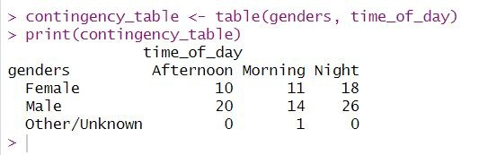
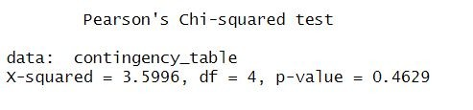
Output
1 0 1 1
1 0 1 1 0 0 1
1 0
1 1 0 1 1
0 1 1
0 1
1 1 0 1 1 0
1 1 0 1 1 1
1 1 0 1

Slide 48
References
https://www.investopedia.com/terms/h/hypothesistesting.asp
https://www.simplilearn.com/tutorials/statistics-tutorial/hyp othesis-testing-in-statistics
https://www.simplilearn.com/tutorials/statistics-tutorial/hyp othesis-testing-in-statistics
https://www.w3schools.com/statistics/statistics_hypothesis_te sting_proportion.php
https://www.analyticsvidhya.com/blog/2020/06/statistics-analy tics-hypothesis-testing-z-test-t-test/
https://www.scribbr.com/statistics/t-test/
1 0 1 1
1 0 1 1 0 0 1
1 0
1 1 0 1 1
0 1 1
0 1
1 1 0 1 1 0
1 1 0 1 1 1
1 1 0 1

